Slide 1
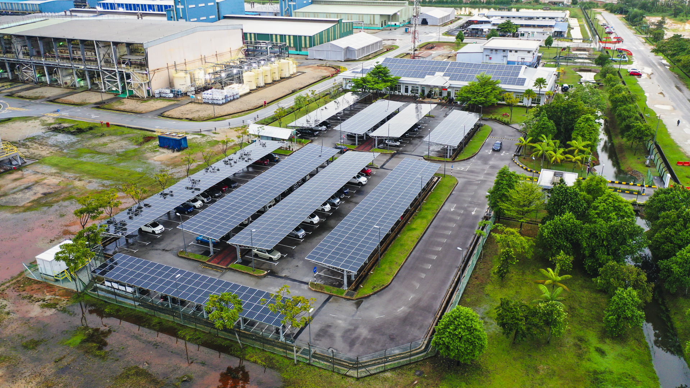
Lynas Rare Earths Update
Xiamen, 14 May 2026

Slide 2
Disclaimer
This presentation has been prepared by Lynas Rare Earths Limited (ABN 27 009 066 648) (Lynas or the Company). This presentation contains summary information about Lynas and its subsidiaries (Lynas Group) and their activities current as at the date of this presentation. The information in this presentation is of general background and does not purport to be complete or to comprise all the information that a shareholder or potential investor in Lynas may require in order to determine whether to deal in Lynas shares. It should be read in conjunction with Lynas group’s other periodic and continuous disclosure announcements lodged with the Australian Securities Exchange (ASX), which are available at www.asx.com.au. This document is not a prospectus or a product disclosure statement under the Corporations act (Cth) 2001 (Corporations Act) and has not been lodged with ASIC.
Not investment or financial product advice
This presentation is for information purposes only and is not financial product or investment advice or a recommendation to acquire Lynas shares and has been prepared without taking into account the objectives, financial situation or needs of individuals. Before making an investment decision, prospective investors should consider the appropriateness of the information having regard to their own objectives, financial situation and needs and seek financial, legal and taxation advice appropriate to their jurisdiction. Lynas is not licensed to provide financial product advice in respect of Lynas shares. Cooling off rights do not apply to the acquisition of Lynas shares.
Financial data
All dollar values are in Australian dollars (A$) unless stated otherwise and financial data is presented within the half year ending 31 December 2025 unless stated otherwise. Any pro forma historical financial information included in this presentation does not purport to be in compliance with article 11 of regulation S-X of the rules and regulations of the US securities and exchange commission.
Market and Industry Data
Certain market and industry data in this presentation may have been obtained from research, diligence, surveys or studies conducted by third parties, including industry or general publications. None of Lynas, its representatives or advisors have independently verified any such market or industry data provided by third parties or industry or general publications.
Cautionary Note Regarding Forward Looking Statements
This presentation contains certain “forward-looking statements” that are based on management’s beliefs, assumptions and expectations and on information currently available to management. The words “expect”, “likely”, “should”, “could”, “may”, “will”, “aim”, “intend”, “propose”, “believe”, “opinion”, “consider”, “predict”, “plan”, “scenario”, “project”, “outlook”, “guidance”, “forecast”, “anticipate”, “target”, “estimate” and other similar expressions within the meaning of securities laws of applicable jurisdictions are intended to identify forward-looking statements. Indications of, and guidance on, future earnings and financial position and performance are also forward-looking statements. Such forward-looking statements include statements regarding Lynas’ expectations about the financial and operating performance of its businesses, statements about the plans, objectives and strategies of Lynas’ management, statements about the industry and markets in which Lynas operates, statements about expected net asset value accretion, expected earnings per share accretion and expected unit cost reduction and statements about the timetable and the outcome and proceeds of the Offer. Forward-looking statements, opinions and estimates provided in this presentation are based on assumptions and contingencies which are subject to change without notice, as are statements about market and industry trends, which are based on interpretations of current market conditions. There can be no assurance that actual outcomes will not differ materially from these forward- looking statements.
You are strongly cautioned not to place undue reliance on forward-looking statements. Any forward-looking statements, opinions and estimates in this presentation speak only as of the date of this presentation and are based on assumptions and contingencies subject to change without notice, as are statements about market and industry trends, projections, guidance and estimates. Any such statements contained in this presentation are not indications, guarantees or predictions of future performance and involve known and unknown risks, contingencies and uncertainties and other factors, many of which are beyond the control of Lynas Group, and may involve significant elements of subjective judgment and assumptions as to future events, which may or may not be correct. Forward-looking statements may also assume the success of Lynas’ business strategies. The success of any of these strategies is subject to uncertainties and contingencies beyond Lynas’ control, and no assurance can be given that any of the strategies will be effective or that the anticipated benefits from the strategies will be realised in the period for which the forward-looking statements may have been prepared or otherwise. Refer to the Section titled “Factors and business risks that affect future performance” of Lynas’ 2025 Financial Report for further information on risks that may affect Lynas.
There can be no assurance that actual outcomes will not differ materially from these forward-looking statements. A number of important factors could cause actual results or performance to differ materially from the forward-looking statements, including (without limitation) the Australian, United States and global economic environment and capital market conditions and other risk factors set out in this presentation. You should consider the forward-looking statements contained in this presentation in light of those risks and disclosures. The forward-looking statements are based on information available to Lynas as at the date of this presentation.

Slide 3
Disclaimer cont.
No representation, warranty or assurance (express or implied) is given or made in relation to any forward-looking statement by any person (including Lynas or any of its advisers). In particular, no representation, warranty or assurance (express or implied) is given that the occurrence of the events expressed or implied in any forward-looking statements in this presentation will actually occur. Actual operations, results, performance, targets or achievement may vary materially from any projections and forward-looking statements and the assumptions on which those statements are based. Except as required by law or regulation (including the ASX Listing Rules), Lynas disclaims any obligation or undertaking to update forward-looking statements in this presentation to reflect any changes in expectations in relation to any forward-looking statement or change in events, circumstances or conditions on which any statement is based.
Past Performance
Past performance information in this presentation is given for illustrative purposes only and should not be relied upon as (and is not) an indication of the Lynas group’s views on its future performance or condition or the future performance or condition of the Lynas group. You should note that past performance, including past share price performance, of Lynas cannot be relied upon as an indicator of (and provides no guidance as to) future performance of the Lynas group, including future share price performance. The historical financial information contained in this Presentation relating to Lynas is, or is based on, information that has previously been released to the ASX.
Investment risk and other risks
An investment in Lynas shares is subject to investment and other known and unknown risks, some of which are beyond the control of Lynas group, including risk factors associated with the industry in which Lynas group operates, such as: nature of mineral exploration and production; mineral and ore reserves; operations risks; project development risks; market price and demand risk; credit and market risks; regulatory, political and environmental risks; tax and other risks generally relating to equity investment. See the section titled ‘’Factors and business risks that affect future performance’’ of the Lynas Rare Earths 2025 Financial Report for further information.
Disclaimer
Lynas and its affiliates, officers, employees, agents and advisers have not authorised, permitted or caused the issue, dispatch or provision of this presentation to any third party. Lynas, its related bodies corporate and their respective affiliates, officers, employees, agents and advisers to the maximum extent permitted by law, expressly disclaim all liabilities in respect of any expenses, losses, damages or costs incurred by you as a result of the information in this presentation being inaccurate or due to information being omitted from this presentation, whether by way of negligence or otherwise, and make no representation or warranty, express or implied, as to the fairness, currency, accuracy, reliability or completeness of information. The information in this presentation remains subject to change without notice.

Slide 4

Rare Earths market being reshaped by global policy decisions
  In Japan, Lynas’ largest market, Japanese magnet makers are winning new business
  Ex-China magnet buyers are seeking direct supply based on supply chain risks
  Strong demand for initial separated HRE products (Dy, Tb, Sm)
Globally governments are taking action to create a functional market and build a secure rare earths supply chain
Rare earths continue to feature in multilateral trade discussions and agreements
Through Lynas, Malaysia plays an important role in the global rare earths supply chain
Bloomberg SHRAPNOX Index performance.
Year to date performance from 1 January 2026 to 11 February 2026
Refer to announcement on 10 July 2025 released by MP Materials “MP Materials Announces Transformational Public-Private Partnership with the Department of Defense to Accelerate U.S. Rare Earth magnet Independence”.

Slide 5
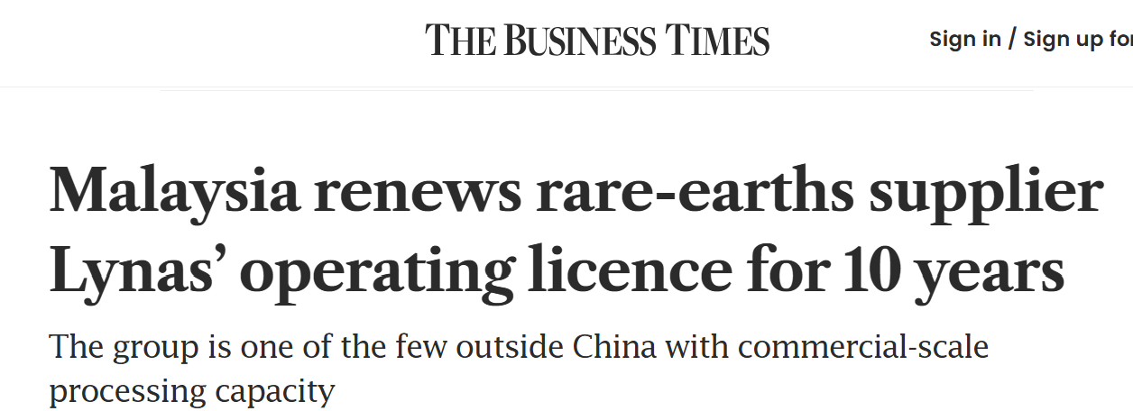
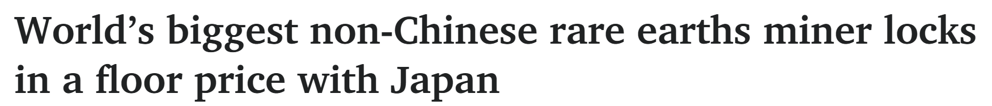
Recent announcements in Malaysia and Japan
10 year operating licence for Lynas Malaysia
Lynas Malasia’s operating licence renewed for 10 years commencing 3 March 2026
Provides investment certainty for Lynas and for our rare earths supply chain partners and customers
12 year JARE supply agreement
Updated long term agreement with Japan Australia Rare Earths B.V. (JARE) to 2038
US$110/kg NdPr floor price
Firm offtake for 5,000 tonnes per annum NdPr and 50% of all HRE oxides produced by Lynas

Slide 6
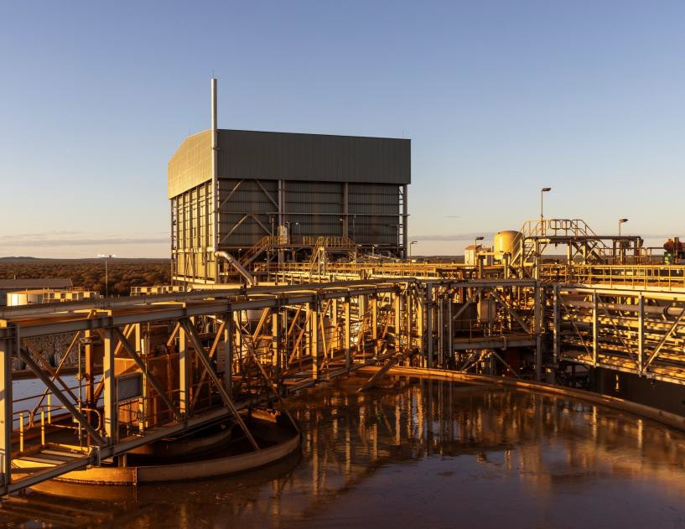
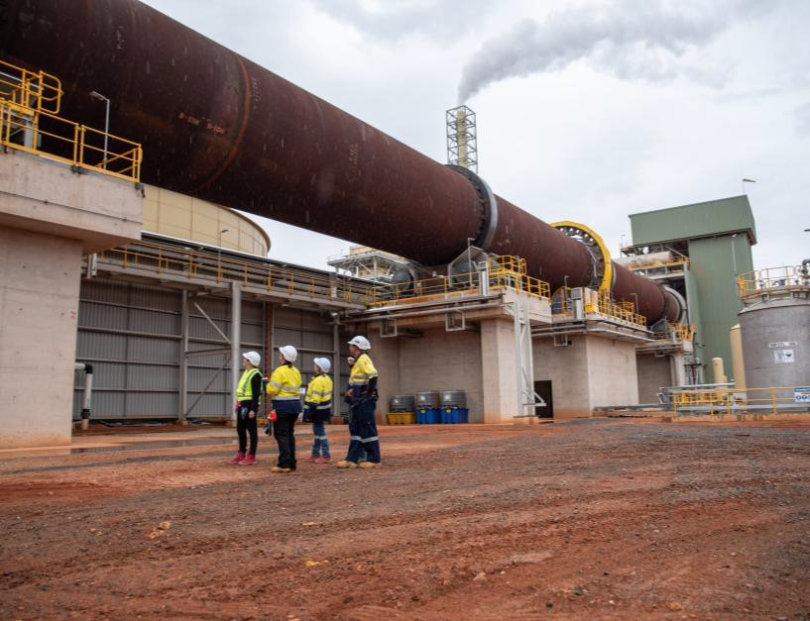
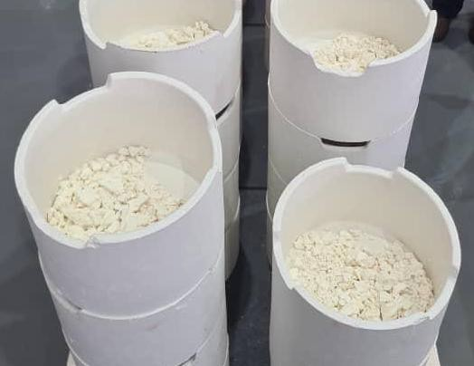
Lynas 2025 investments complete
Mt Weld set for next decade
Plant rebuilt with expanded processing capacity
Mineral Resource and Ore Reserve Update published with >20 years mine life at expanded production rates above¹
New Hybrid Power Station
Kalgoorlie facility integrated into global operations
New facility constructed and operating
MREC production shipped to Lynas Malaysia for separation
Continuous flowsheet improvements
Lynas Malaysia upgrades create a future facing facility
Additional process completed for MREC receival
Capacity uplift for Solvent Extraction and Product Finishing production
New Heavy Rare Earth products & expanded HRE facility announced
¹ Refer to announcement on 5 August 2024 “2024 Mineral Resource and Ore Reserve Update”: https://wcsecure.weblink.com.au/pdf/LYC/02835257.pdf.
4

Slide 7
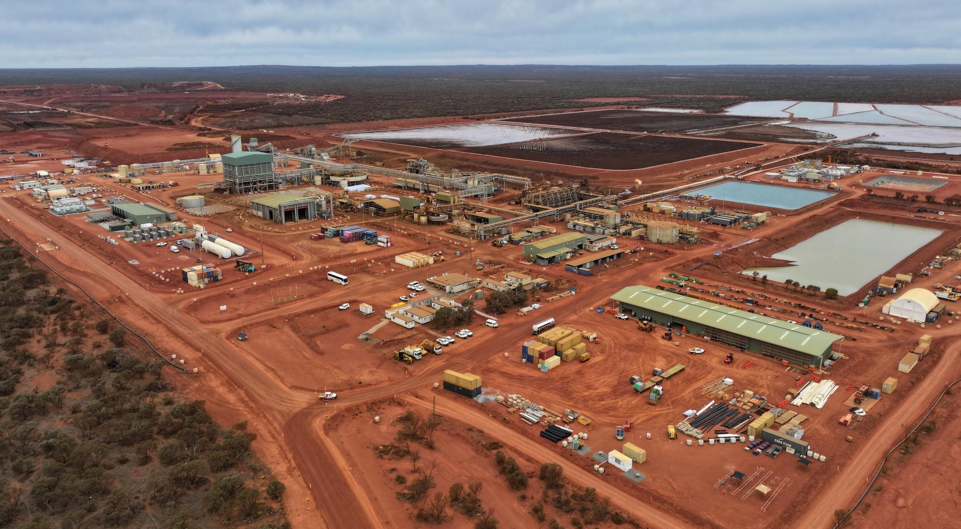

Mt Weld concentrate plant expansion
Increased Capacity
Improved Efficiency
Enhanced Sustainability
5

Slide 8
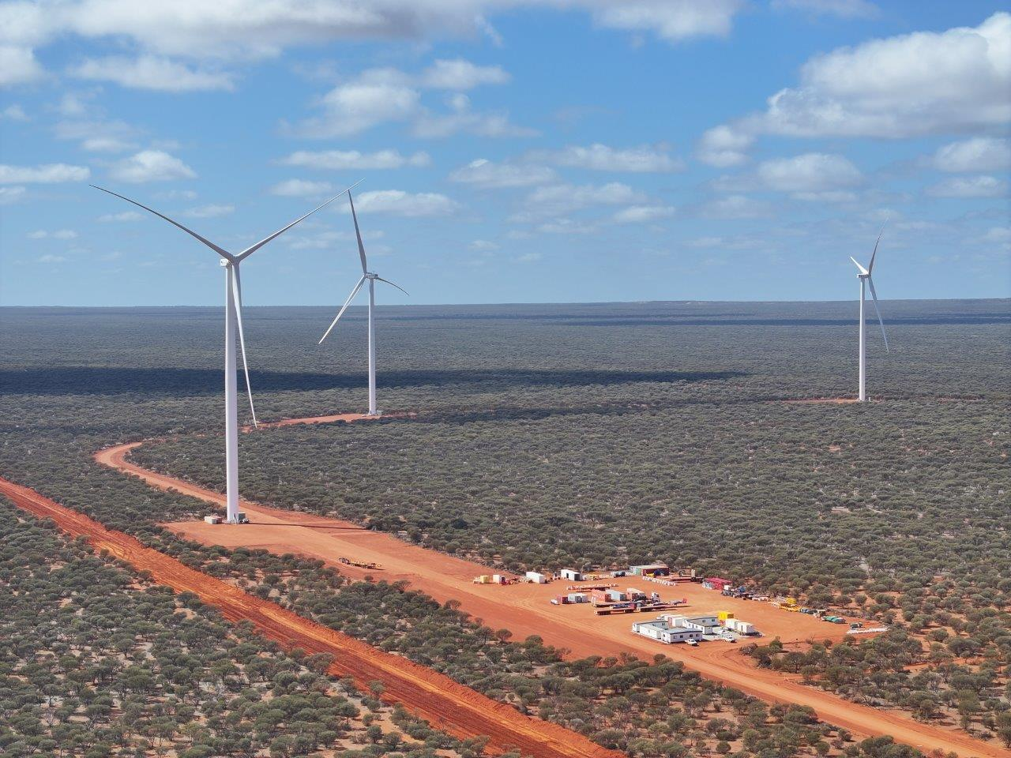
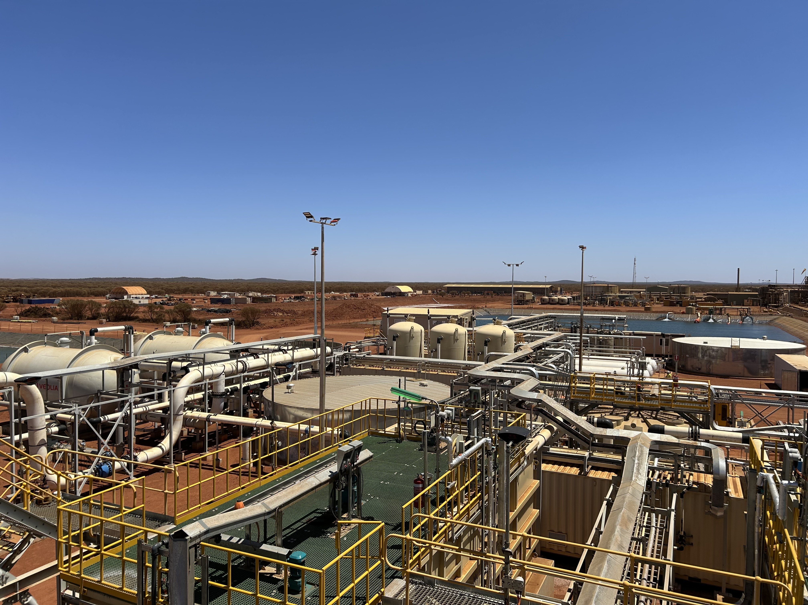
Enhanced sustainability with Mt Weld hybrid power station and water recycling
Commissioning of 65MW Mt Weld hybrid power station completed
92% renewable electricity produced in Dec 2025; above target of 70% renewable content
Commissioning of bore water treatment plant & recycled water plant completed
Ability to achieve target of 90% of tailings water recycled demonstrated

Slide 9
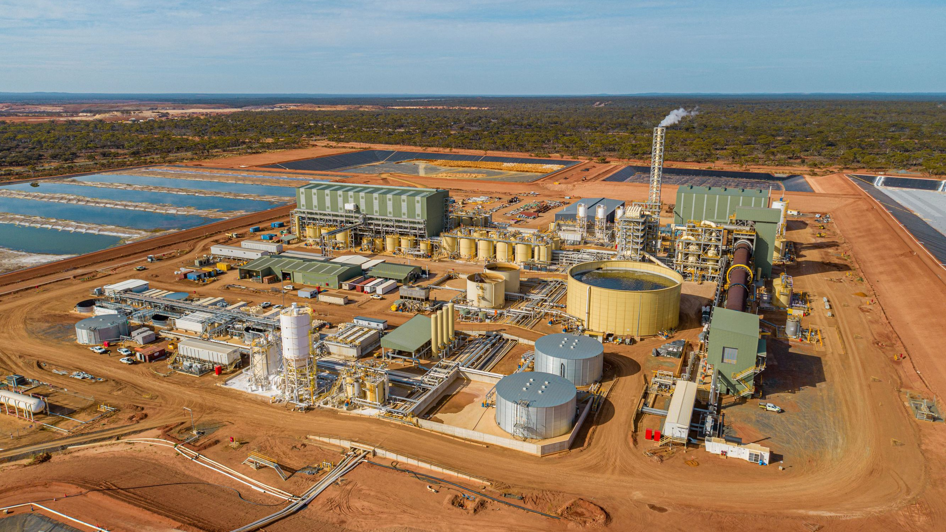
Kalgoorlie Rare Earths Processing Facility
Plume from stack is water
vapor (“steam”)
Automated filter press
Rotainer logistics
Waste gas treatment
Onsite laboratory
110m long kiln
Photo: Kalgoorlie Facility Nov 2024
7

Slide 10
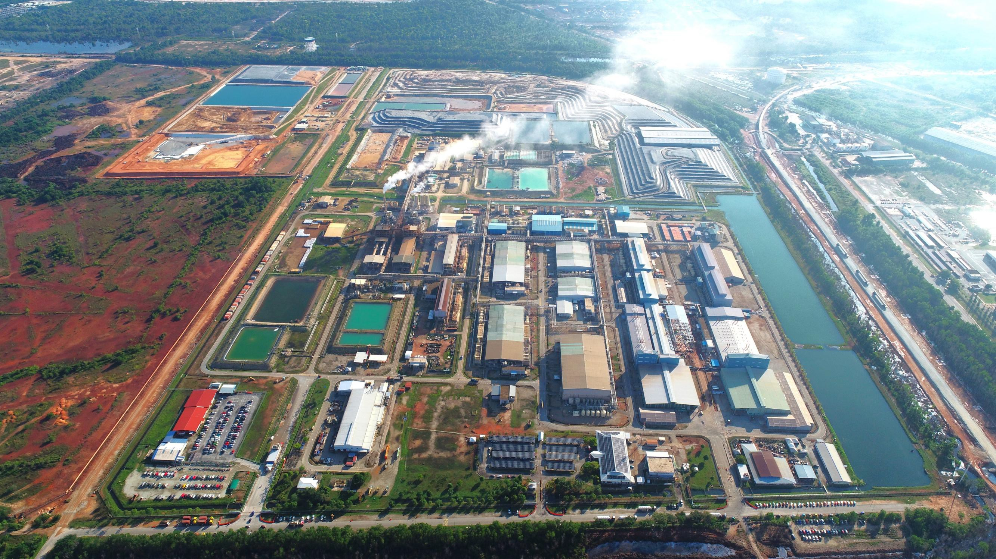
Lynas Malaysia
Plume from stack is water
vapor (“steam”)
WLP Permanent Disposal Facility
under construction
Previous WLP Residue
Storage Facility
NUF storage facility
MREC receival
Waste gas treatment stacks
Kilns
Product finishing
Primary and secondary leaching
Onsite laboratory
New rotary filter and rotary furnace
Solvent extraction
Storm water
retention pond
Rooftop solar array

Slide 11
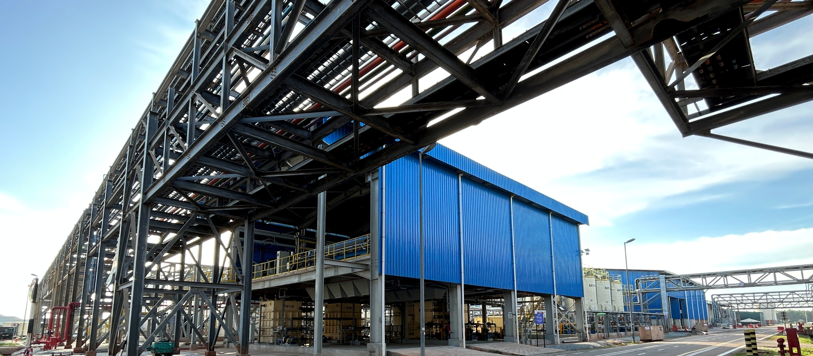
Lynas Malaysia
New processes and expanded production capacity
New rotary furnaces installed to increase Product Finishing efficiency
  Solvent Extraction and Product Finishing uplift to 10.5kt p.a. nameplate capacity¹
Lynas Malaysia 0.75MW rooftop solar array commissioned & operating
First MREC from Kalgoorlie processed in FY25
1. This is a reference to the nameplate processing capacity at the relevant facility based on current equipment configuration at the facility. It is not, and is not intended to be, a production target for the purposes of Chapter 5 of the ASX Listing Rules or a projection or forecast of the amount of minerals to be extracted or produced for any particular period.
11

Slide 12
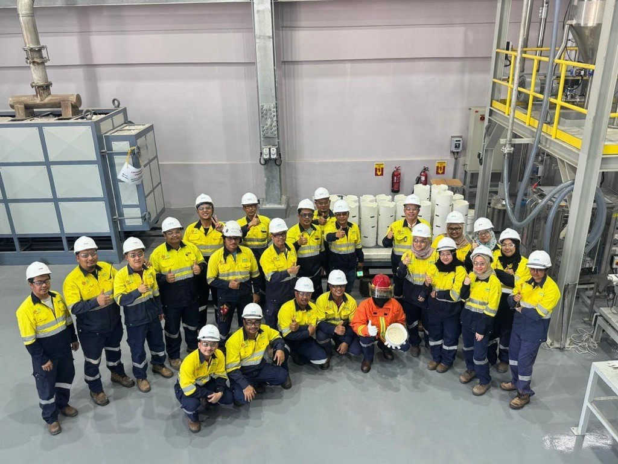
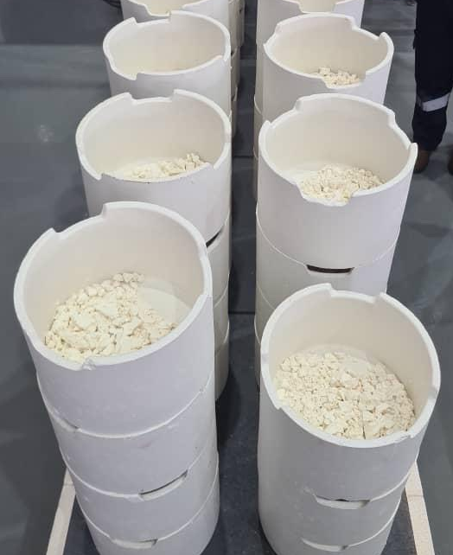
First production of separated Heavy Rare Earths
Lynas is now the only commercial producer of separated Dy, Tb & SA ex-China
Growing with the market
First separation of Dy oxide and Tb oxide in May and June 2025; first separation of Sa oxide March 2026

Slide 13
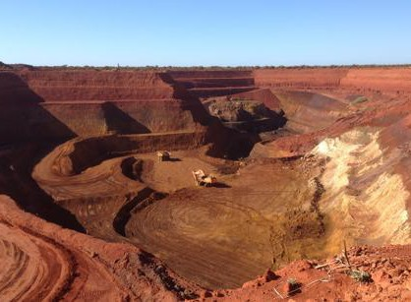
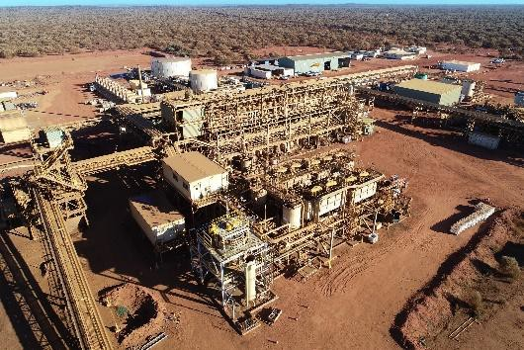
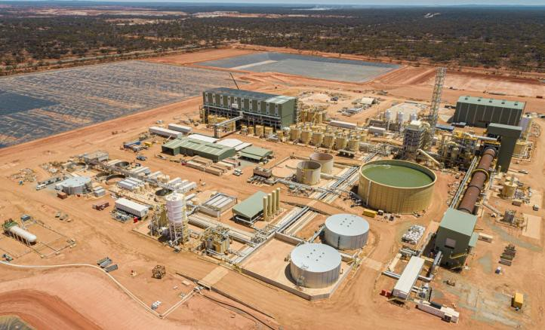
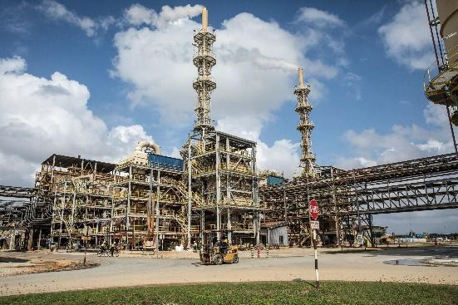
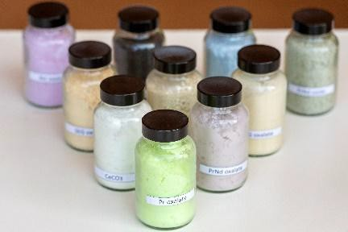
Lynas provides an ethical and responsible supply chain from mine to finished product
Ore is mined from the Mt Weld pit; Light
Rare Earths and Heavy Rare Earths
Mt Weld Concentration Plant: crushing, grinding, floatation, filtration, concentrates
Kalgoorlie Rare Earths Facility: initial processing of concentrate into Mixed Rare Earth Carbonate (MREC)
Shipped to Malaysia
Lynas Malaysia Advanced Material Plant, Gebeng:
cracking and leaching, separation, product finishing
Separated Rare Earths products exported to customers in Asia, Europe, US and Rest of World

Slide 14
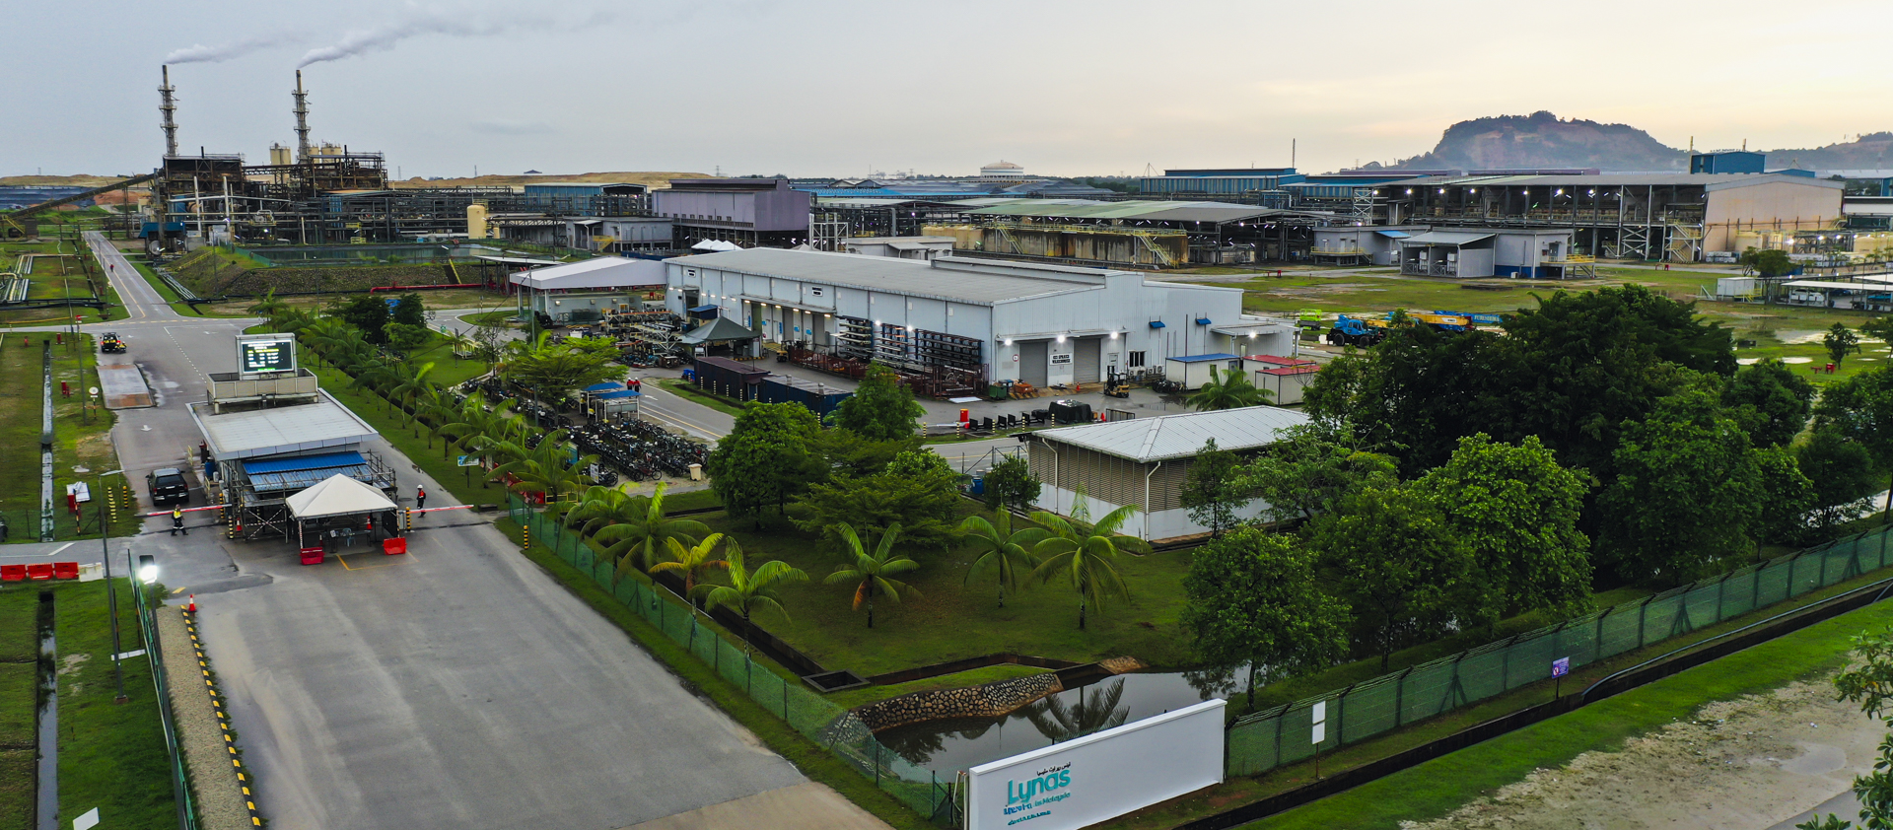
Heavy Rare Earth production and expansion at Lynas Malaysia
Ready for sale REO production 6,375t, including 3,407t NdPr
HRE production expansion announced October 2025; first Samarium production targeted for Q4 FY26
Major maintenance completed Dec 2025 quarter; cracking & leaching successfully restarted Jan 2026
  Solvent Extraction and Product Finishing nameplate capacity 10.5kt p.a. ¹
1. This is a reference to the nameplate processing capacity at the relevant facility based on current equipment configuration at the facility. It is not, and is not intended to be, a production target for the purposes of Chapter 5 of the ASX Listing Rules or a projection or forecast of the amount of minerals to be extracted or produced for any particular period.
14

Slide 15
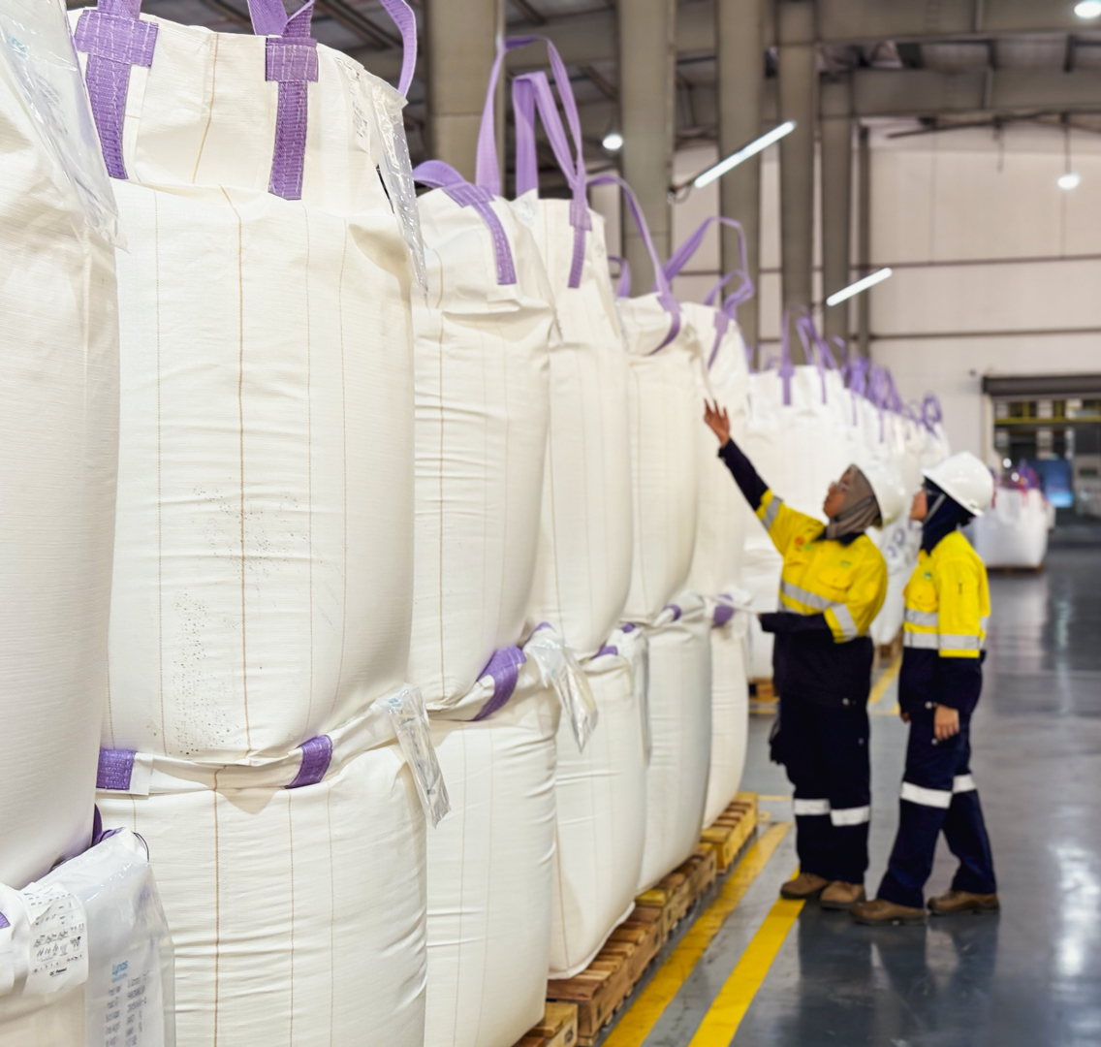
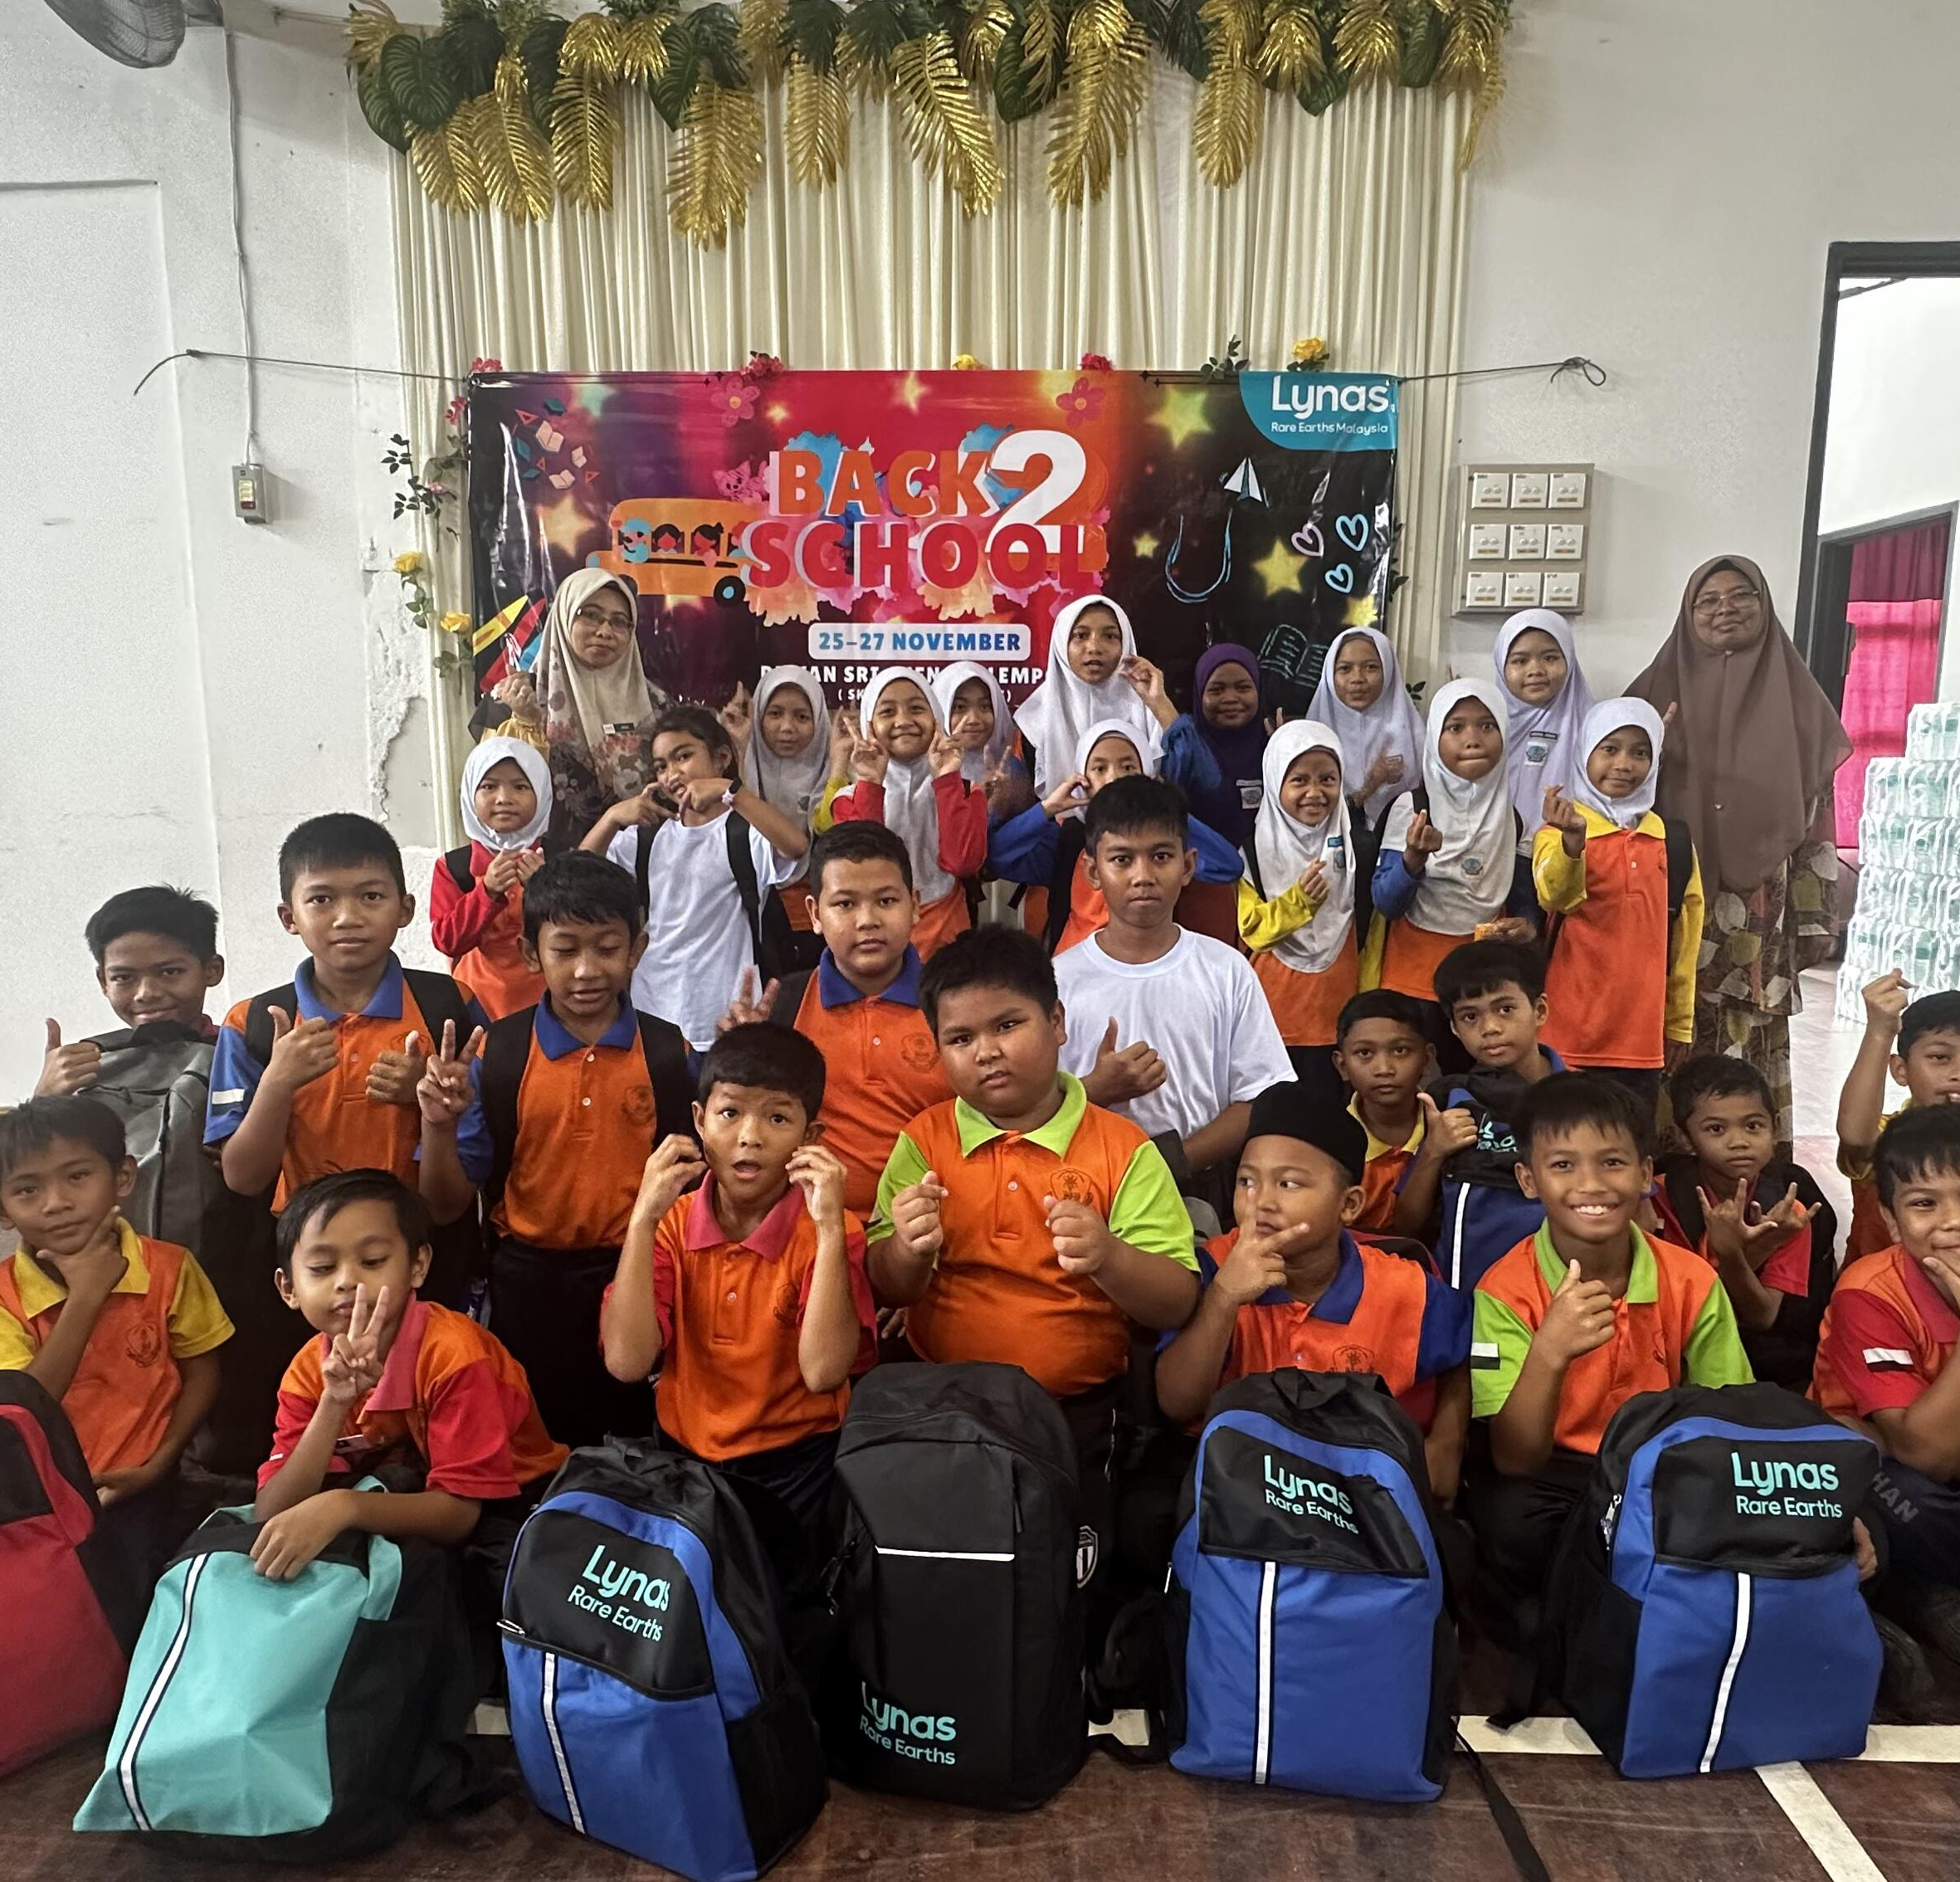
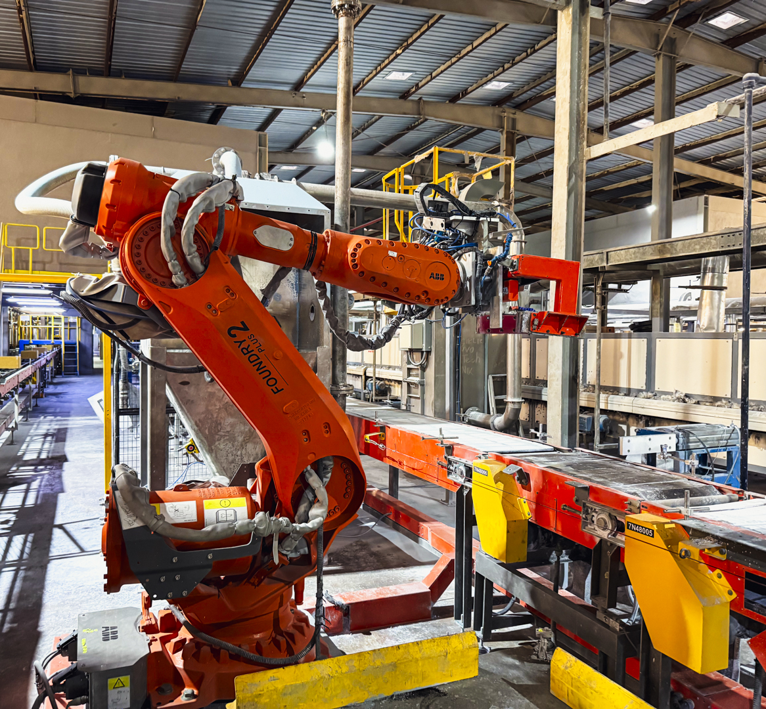
Caring for our people, communities & environment
Enhancing sustainability
98% of Lynas Malaysia employees are Malaysian nationals
Lynas Malaysia solar array commissioned & operating since H2 FY25
98% of Lynas Malaysia employees are Malaysian nationals
Lynas Malaysia solar array commissioned & operating since H2 FY25
98% of Lynas Malaysia employees are Malaysian nationals
Lynas Malaysia solar array commissioned & operating since H2 FY25
Lynas Malaysia held its annual Back to School programme in November 2025
Over 480 local students from 18 schools assisted with supplies for 2026
Continued investment in R&D for process improvement & GHG reduction
15

Slide 16
Estimation of global NdFeB magnet production
Growing with the market
Global market share of Chinese magnet could move down from 95% in 2024 to 90% in 2030 (assumed 5% annual growth in China)
3 New projects are already in operation and another 1 in commissioning
Demand growth is expected in between 5% and 8% in the coming years Main driver of growth is wind power & NEV in EU

Slide 17
Global PrNd Balance
Growing with the market
Production in China in 2025 is estimated volume due to unavailable quota volume.
Imported ore separation is controlled by quota system from 2025. Supply-Demand in 2025 was tightly balanced which led market price up
Non Chinese+Japanese magnet production will grow 10 fold in 5 years

Slide 18
Chinese NdFeB magnet export volume statistics
Growing with the market

Slide 19

DRAFT
  Visit us at LynasRareEarths.com

Slide 20
Appendix A: JORC Compliance and Competent
Person’s Statement
Exploration Results
The information in this report is based on, and fairly represents information and supporting documentation jointly prepared by Marcelle Watson, Geology Manager, and Dr. Ganesh Bhat, Principal Resource Geologist. Marcelle Watson is a full-time employee of Lynas Rare Earths Ltd and member of AusIMM. Dr Ganesh Bhat is a full-time employee of Lynas Rare Earths Ltd and member of AusIMM. Ms Watson and Dr Bhat have the relevant experience in relation to the mineralisation being reported on to qualify as a Competent Persons as defined in the Joint Ore Reserves Committee (JORC) Australasian Code for Reporting of Exploration Results, Identified Mineral Resource and Ore Reserves 2012. Ms Watson and Dr Sadangaya Ganesh Bhat consent to the disclosure of information in this report in the form and context in which it appears.
The potential extent and grade of the Fresh Carbonatite is unknown at this stage. Drilling has been completed to 200 metres below surface. The Exploration Results have been prepared and reported in accordance with the 2012 edition of the JORC Code.
Mineral Resources and Ore Reserves
Full details of the material change that occurred in 2024 are reported in the Lynas ASX announcement dated August 5, 2024, titled “2024 Mineral Resource and Ore Reserve update: Lynas announces a 92% increase in Mineral Resources and a 63% increase in Mt Weld Ore Reserves - with significant increase in contained heavy rare earth mineralisation”. The company confirms that all material assumptions and technical parameters underpinning the estimated Ore Reserves and any production targets set out in the ASX announcement dated August 5, 2024 continue to apply and have not materially changed. Refer to announcement on Lynas Rare Earths website: https://wcsecure.weblink.com.au/pdf/LYC/02835257.pdf.
20

